Slide 1


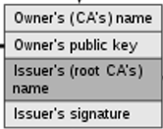
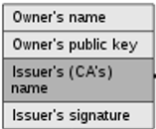
Root certificate
reference
Intermediate certificate
reference
sign
End-entity certificate
sign

